Slide 1
{
“한국”,
“비밀번호”,
“가나다”
}
{
{ “ㅎ”, “ㅏ”, “ㄴ”, “ㄱ”, “ㅜ”, “ㄱ” },
{ “ㅂ”, “ㅣ“, “ㅁ”, “ㅣ”, “ㄹ”, “ㅂ”, “ㅓ”, “ㄴ”, “ㅎ”, “ㅗ” },
{ “ㄱ”, “ㅏ”, “ㄴ”, “ㅏ”, “ㄷ”, “ㅏ” }
}
Word separation
{
{ “g”, “k”, “s”, “r”, “n”, “r” },
{ “q”, “l“, “a”, “l”, “f”, “q”, “j”, “s”, “g”, “h” },
{ “r”, “k”, “s”, “k”, “e”, “k” }
}
Alphabetical
transformation
{
{“gksrnr”},
{“qlalfqjsgh”},
{“rkskek”}
}
Combining
Alphabetics

Slide 2
말
joongsung
마
chosung
chosung
joongsung
jongsung
(a)
(b)

Slide 3


(a) Registrarion
“password1234”
hashing
“k2j3hd …… 249”
Save password
User
(b) Authentication
“password1234”
hashing
“k2j3hd …… 249”
Match
no match
match
(c) Password cracking
Denied
Granted
User profile
“q1w2e3r4”
hashing
“0cu443 …… enm”
“key123@@”
hashing
“08ffxa …… 4r2”
Match
Hacker
. . .
. . .
no match
match
Failed
Succeeded
“abcdefg”
hashing
“akd2jd …… 1f2”

Slide 4
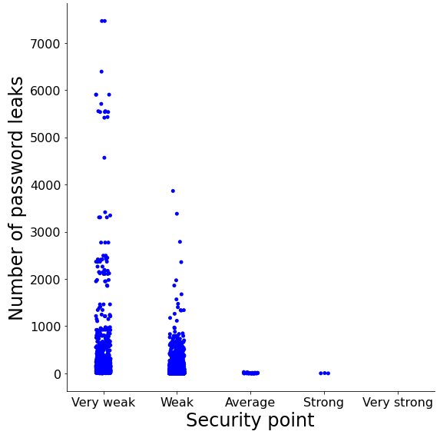
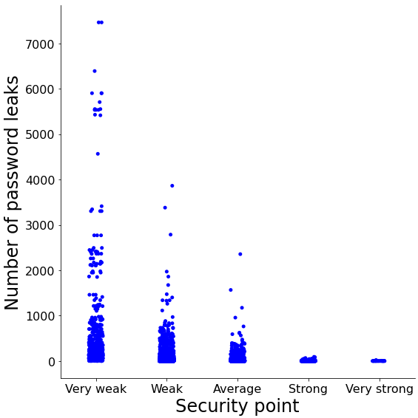
Number of password leaks
Number of password leaks
Security evaluation score
Security evaluation score
(a)
(b)

Slide 5
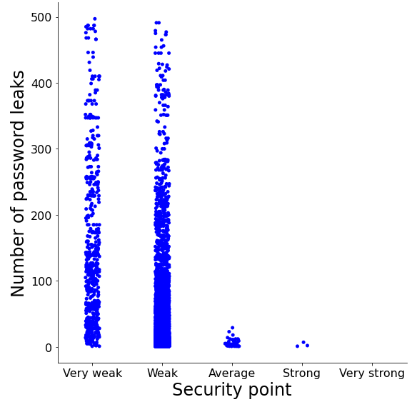
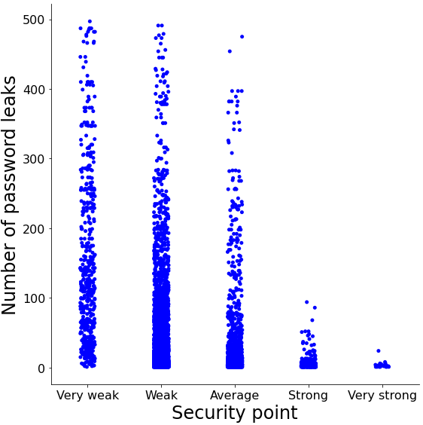
Security evaluation score
Number of password leaks
Number of password leaks
Security evaluation score
Security evaluation score
(a)
(b)

Slide 6


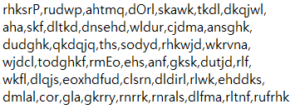
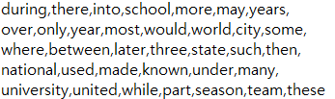
. . .
. . .
(a)
(b)

Slide 7
. . .
. . .
(a)
(b)

Slide 8
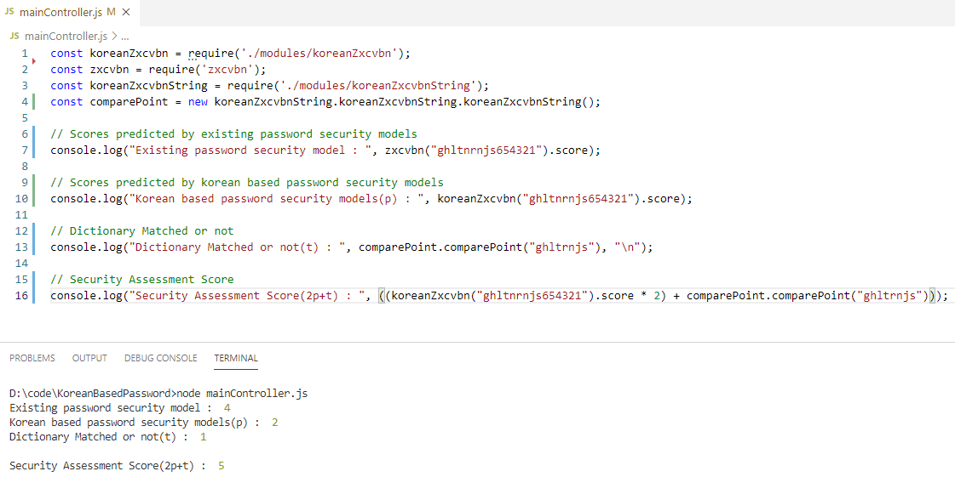
(a)
(b)

Slide 9

zxcvbn point
calculation
“pas123sword@”
Password dictionaries
Password security evaluation index
Password
dictionary 1
“pas123sword@”
“pas123sword@”
zxcvbn point
calculation
Evaluation score
password security level
Evaluation score
. . .
Password
dictionary N
“password”
“password”
Whether password matches dictionary
Verify
string match
Korean word
password dictionaries
password security analysis
Whether password matches dictionary
Korean word
password
dictionary 1
Password security
assessment
. . .
Korean word
password
dictionary N
Security evaluation socre
Evaluation
security score
Name of a man used a lot by koreans

Slide 10
(a) Construction for Korean word password dictionary
Password dictionaries
{
“한국”,
“비밀번호”,
“가나다”
}
Password
dictionary 1
Word separation
Alphabetical
transformation
Combining
alphabetics
. . .
Korean
word data
Password
dictionary N
(b) Evaluation for korean word based password security
Korean word
password dictionary
zxcvbn point
calculation
Verify
string match
Korean word
password
dictionary 1
“비밀번호12@”
Combining
alphabetics
zxcvbn Point
calculation
User
security level
security analysis
. . .
Korean word
password
dictionary N
{
security level,
security analysis
}
Password security
evaluation
File N
Evaluation security score

